Slide 1
Madera County Department of Behavioral Health Services (BHS) 2018
David Weikel, PsyD.
Behavioral Health Program Supervisor

Slide 2
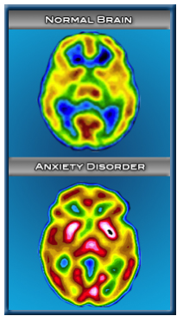
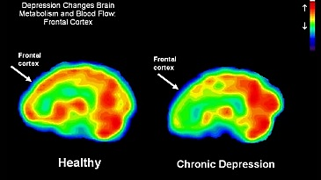
Brian Scans: Healthy and Unhealthy Brains
Anxiety
Depression

Slide 3
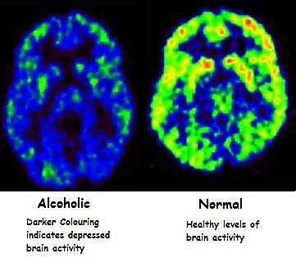
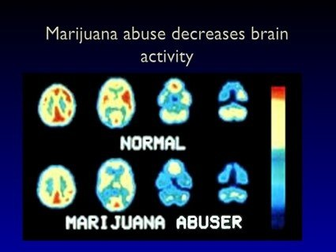
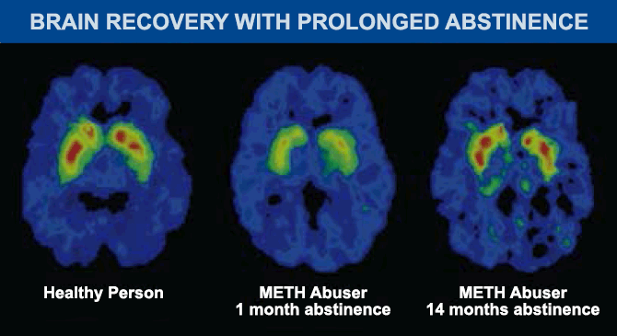
Brian Scans: Healthy and Unhealthy Brains

Slide 4
Behavioral Health Services
Non-MHSA Mental Health Services
MHSA Services
Substance Use Treatment Services
Substance Use Prevention Services

Slide 5
Need for Mental Health Services FY 16/17
Mental Illness Prevalence
County Mental Health Eligibility
People with Any Diagnosable Mental Illness = 11,528
  Adults (18+) = 7,791
  Children (0-17) = 3,737
Adult Eligible = 3,660
Youth Eligible = 2,600
Served
  Adult (18+) 2,657 (43%)
  Children (0-17) 1,741 (67%)

Slide 7
BHS Services
Outpatient
MHSA
Service Eligibility Screening
Clinical Assessment
Counseling/Therapy
  Individual and Group
  MH & SUD
Psychiatric/Medication
Crisis Services
Case Management /Rehab
Community Services & Supports
  Full Service Partnerships
    Child/TAY
    Adult/Older Adult
  System Development
    Expansion
    Supportive Services and Structure
Prevention & Early Intervention
Housing (for specific groups)
Statewide Projects
Workforce Education and Training

Slide 10
Crisis Response FY 16-17
3,398 Crisis Calls
12% of Crisis Calls Resulted in Psychiatric Hospitalization

Slide 11
Mental Health Services Act (MHSA)
Community Services and Supports
Prevention and Early Intervention
Innovation
Time Limited Funds (Housing, WET)

Slide 12
MHSA Values
Community Collaboration
Culturally and Linguistically Responsive
Consumer/Family Driven
Wellness, Recovery, & Resilience Focus
Integrated Service Experience
Reduction of Negative Outcomes of Untreated Mental Illness:
  (1) Suicide.
  (2) Incarcerations.
  (3) School failure or dropout.
  (4) Unemployment.
  (5) Prolonged suffering.
  (6) Homelessness.
  (7) Removal of children from their homes.

Slide 13
Mental Health Services Act
Community Supports and Services (CSS)
FY 16/17

Slide 14
Full Service Partnerships Service Outcomes
FY 14/15, 15/16 & 16/17

Slide 15
Full Service Partnerships Service Outcomes
FY 14/15, 15/16 & 16/17

Slide 16
Full Service Partnerships Service Outcomes
FY 14/15, 15/16 & 16/17

Slide 17
Full Service Partnerships Service Outcomes
FY 15/16 and FY 16/17
(Time Frames Changed to Quarters and Not Years)

Slide 18
Full Service Partnerships Service Outcomes -FY 14/15, 15/16, 16/17

Slide 19
Full Service Partnerships Service Outcomes
FY 13-14, 14-15, 15-16 & 16-17

Slide 20
Full Service Partnerships Service Outcomes
FY 14/15, FY 15/16 & 16/17

Slide 21


Please rank and rate survey options.
1, 2, 3 … or
a, b, c

Slide 22
MHSA - System Development Service Outcomes
FY 14/15, FY 15/16 & FY 16/17
Supportive Services & Structure
  Adds Administrative Support for Direct Services

Slide 23
Mental Health Services Act
Prevention & Early Intervention (PEI)
Purpose
Service Categories
Mental Health Promotion & Disability Prevention
  Promote Protective Factors
  Reduce Risk Factors
Programs
  Community Outreach & Wellness Centers
  Community & Family Education
  Information Dissemination
  Education
  Access and Linkage to Treatment
  Alternatives
  Community Based Process
  Environmental

Slide 24
Social Ecological Model & Behavioral Health Services
Individual – personal attitudes, beliefs, and skills/behavior
Interpersonal Relationships – people closest to individuals who influence their behavior (e.g. family, friends, close friends)
Organizations – Common organizational rules and polices that direct people’s behavior which provide social identity and role definition
Community – Areas of individual’s community that reinforce social norms/culture that affect an individual’s behavior (e.g. schools, worksites, religious groups)
Social Structure – Local, state and national laws that affect personal behavior through organizations and other groups
Community
Organizations
Interpersonal
Individual
Society/Culture

Slide 25
PEI FY 14/15, 15/16 & 16/17

Slide 26
PEI Demographics

Slide 28
Voluntary Disclosure of Sexual Orientation Required by Mental Health Services Oversight and Accountability Commission
Sexual Orientation FY 16-17
 | Hope House | Mountain Wellness Center | MH Educator, Community Health Worker and CalWORKs | YEP | Totals FY 16/17 | Totals FY 15/16
Gay or Lesbian | 1 | 0 | 0 | 6 | 7 | 0
Heterosexual or Strait | 14 | 0 | 1 | 107 | 122 | 109
Bisexual | 0 | 0 | 1 | 18 | 19 | 0
Questioning or Unsure | 1 | 0 | 0 | 5 | 6 | 0
Queer | 0 | 0 | 0 | 1 | 1 | 0
Another Sexual Orientation | 0 | 0 | 0 | 2 | 2 | 0
Decline to Answer | 3 | 4 | 10 | 2 | 19 | 0

Slide 29
Voluntary Disclosure of Sexual Orientation Required by Mental Health Services Oversight and Accountability Commission
Gender Assigned at Birth FY 16-17
 | Hope House | Mountain Wellness Center | MH Educator, Community Health Worker and CalWORKs | YEP | Totals FY 16/17 | Totals FY 15/16
Male | 17 | 0 | 18 | 121 | 156 | 3
Female | 9 | 0 | 144 | 162 | 315 | 106
Decline | 0 | 4 | 79 | 0 | 83 | 0
Current Identity FY 16-17
 | Hope House | Mountain Wellness Center | MH Educator, Community Health Worker and CalWORKs | YEP | Totals FY 16/17 | Totals FY 15/16
Male | 19 | 0 | 34 | 112 | 165 | 3
Female | 11 | 0 | 38 | 152 | 201 | 106
Transgender | 0 | 0 | 0 | 0 | 0 | 0
Genderqueer | 0 | 0 | 0 | 3 | 3 | 0
Questioning/Unsure | 0 | 0 | 0 | 3 | 3 | 0
Another Gender | 0 | 0 | 0 | 0 | 0 | 0
Decline to Answer | 0 | 0 | 95 | 2 | 97 | 0

Slide 30
Please rank and rate survey options.
1, 2, 3 … or
a, b, c

Slide 31
MHSA Innovation
Purpose
Current & Proposed
Pilot new projects
Primary Purpose Options:
    Increase access to MH services
    Increase access to MH services to underserved groups
    Increase the quality of mental health services (measurable outcomes)
    Promote interagency and community collaboration related to mental health services or supports or outcomes
Current Initiatives
  Nurture 2 Nurture Madera
    Promote Interagency & Community Collaboration
    Improve Client Outcomes for Mom’s At-Risk of Perinatal Mood & Anxiety Disorder (PMAD)
  Peer to Peer/Family Community Re-entry Services
      Video Conferencing between Institutions of Client and Peer Support and Peer Follow Up Upon Release

Slide 32
2 More MHSA Innovation Ideas
1. Increasing Access to Mental Health Services
2. Increasing Access to Mental Health Services
Partnering with CSUF Nursing School Mobile Clinic
Rational
  Integrating mental health services would help to reach hard to reach populations
    Increasing access reducing to distance between home and services
    Reducing stigma related to mental illness by delivering services in a health setting
    ACEs Screener
Addressing barriers to accessing dialing living needs related to cognitive trauma.
  Screening Adverse Childhood Experiences (ACEs)that compromise people’s ability to meet their needs
  Educate Impact of ACEs
  Facilitate to needed daily living needs (e.g. Prevention Education, Treatment, Basic Living Needs)

Slide 33
Nurture 2 Nurture Measures
Collaboration Measures FY 16-17
 | FY 15-16 | FY 16-17
Total Individuals | 153 | 225
Total Contacts | Not Collected | 4,778
Outreach
Total | 3,095
Comparison of Collaborative Strengths Dimensions Between 2015 and 2016
 | 2015 | FY 2016-2017
 | n = 14 | n = 5 | t
Collaborative Environment | 3.77 (.30) | 4.10 (.29) |  | 1.75
Collaborative Communication | 3.43 (.48) | 4.12 (.41) | 2.84*
Member Characteristics | 3.55 (.60) | 4.10 (.38) | -1.90
Collaborative Purpose | 3.78 (9.38) | 4.03 (.06) | -1.44
Resources Available | 3.40 (.49) | 3.60 (.42) | -.79
Collaborative Process | 3.25 (.59) | 4.18 (.36) | 3.25**
Notes: * p < .05. ** p ,.001. n =14 in 2015. n = 5 in FY 2016-2017.

Slide 34
Stakeholder Satisfaction 2015 & FY 2016-17
Survey Dimension | Average Percent Satisfied (2015) | Average Percent Satisfied (2016-17)
Planning & Implementation | 72 | 62.9
Leadership | 77 | 67
Diversity of Perspective | 67 | 65
Progress and Capacity | 67 | 67.5

Slide 35
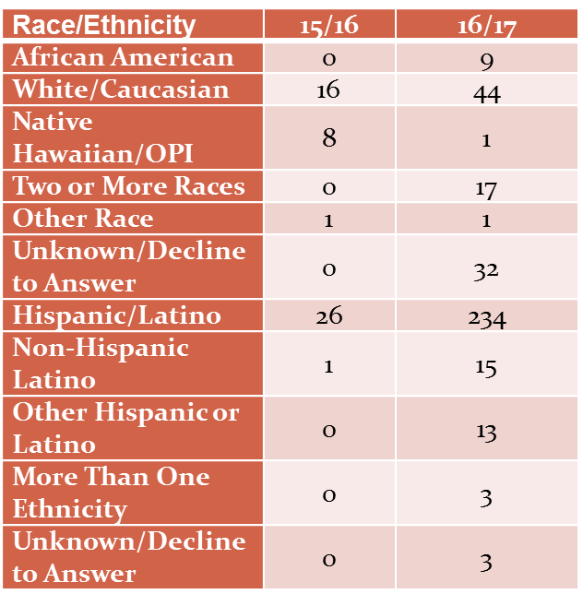
Nurture 2 Nurture Madera (N2N-M) & Maternal Wellness Coalition (MWC)
Organizations and Individuals Represented FY 16-17
 | People | Sessions
Health Care | 222 | 11
Law Enforcement | 1 | 1
Community Member | 3,766 | 38
Behavioral Health Client | 142 | 142
Behavioral Health Staff | 38 | 4
Social Services | 38 | 3
CBO | 38 | 3
Education/Schools | 15 | 3
Maternal Wellness Coalition | 19 | 1
Nurture to Nurture Madera | 4,759 | 410
WIC | 17 | 17

Slide 36
Language
Ages of Direct Service Clients
 | FY 15/16 | FY 16/17
American Sign Language | 0 | 0
Armenian | 0 | 0
English | 13 | 152
Hmong | 0 | 0
Portuguese | 0 | 0
Spanish | 15 | 123
 | FY 15/16 | FY 16/17
0-15 | 0 | 0
16 - 24 | 5 | 192
25-59 | 16 | 418
60+ | 0 | 30
Decline to Answer | 0 | 333
Total | 21 | 973

Slide 37
Nurture 2 Nurture Madera (N2N) FY 16/17
Groups and Trainings Topics/Type FY 16-17 | People | Sessions
Class on Children and Family Health at Madera Community College | 22 | 1
Crossing Lines | 19 | 1
First 5 Baby Shower | 24 | 3
Maternal Depression Support Groups | 56 | 7
Maternal Wellness Coalition | 19 | 2
Nurturing Parenting Classes | 95 | 14
PEI Providers Meeting - Goals | 8 | 1
Perinatal Mood and Anxiety Disorder Training | 308 | 32
Perinatal Mood and Anxiety Disorder - Phone Support | 28 | 28
Perinatal Mood and Anxiety Disorder Support Group | 336 | 54
Pre and Post Results from the Trainings FY 16-17 | Pre | Post
12.2% Net Gain in PMAD Understanding (p. < .0001) | 139 | 115

Slide 38
Nurture 2 Nurture Madera (N2N-M) &
Maternal Wellness Coalition (MWC)
Key Finding
Relatively low levels of PMAD awareness exist for Madera residents; efforts to increase awareness continue.
Estimates of Madera County PMAD prevalence rates are at least 19.5%.
N2N referrals have increased.
PMHIP and the MWC appear to have enhanced the capacity to identify and treat women with PMAD.
N2N support services and competency training indicate that are effective.
Two measures indicate an enhanced coalition strength.
Key Informant Interviews indicate that coalition members benefit professionally from their MWC membership; their clients were reportedly better served by coalition members and their agencies.

Slide 39
Please rank and rate survey options.
1, 2, 3 … or
a, b, c

Slide 40
MHSA Housing Projects
MHSA Housing Program
  Four Bedroom House - Supportive/Shared Housing Project – Madera
  Four-plex Supportive/Shared Housing Project – Chowchilla
  Additional Project: Seven Bedroom Apartment Project in Oakhurst Area
  One Time Housing Assistance to Prevent Homelessness

Slide 41
Workforce Education & Training
BHS Staffing Race/Ethnicity
 | 2017 | 2016 | 2015 | 2014
White | 45 | 46 | 43 | 50
Hispanic | 82 | 80 | 65 | 55
African American | 8 | 10 | 7 | 10
Asian | 4 | 5 | 3 | 3
Staffing Needs
Psychiatrist (especially certified specialties) Registered Nurses LCSW/LMFT Therapists ASW/MFT (Pre-licensed) Certified AOD Counselor Hispanic/Spanish Speaking Direct Service Providers
Improvements (2013 – 2017)
11% Increase in Hispanic Clinicians 45% - 56% 23% Increase in Spanish Speaking Staff - 25% - 47% Overall Hispanic Employees in MCBHS - 56%

Slide 42
Madera Mental Health Funding Amounts by Category
FY 16/17 Total = $22,876,502 (20% increase from FY 15/16)

Slide 43
Substance Use Disorders (SUD) Services
Treatment
Prevention Services

Slide 44
FY 16/17 Substance Use Disorder Prevalence in Madera County
& BHS Substance Use Services
Total People with Diagnosable Substance Use Disorder (SUD)
  Any Substance Use – 14,915
  Total Eligible - 6,253
Eligible People with Diagnosable Substance Use Disorder (SUD)
  Eligible SUD (Adults) 5,392 (Children 0-17 yrs.) 859
  Served SUD (Adults) 419 (7%) (Children 0-17) 71 (8%)

Slide 45
SUD Statistics – CA & Madera

Slide 46
Treatment Referral Sources For FY 16/17

Slide 47
Assessing Services Information & Changes During Treatment for FY 16/17

Slide 48
Substance Use – Age FY 16/17

Slide 49
Demographic for FY 16/17

Slide 50
Primary Drug FY 16/17

Slide 51
Services Information & Changes During Treatment

Slide 52
Changes During Treatment for FY 14/15 - FY 16/17

Slide 53
Service Utilization & Treatment Population FY 14/15 - FY 16/17

Slide 54
Please rank and rate survey options.
1, 2, 3 … or
a, b, c

Slide 55
SUD Prevention Services

Slide 56
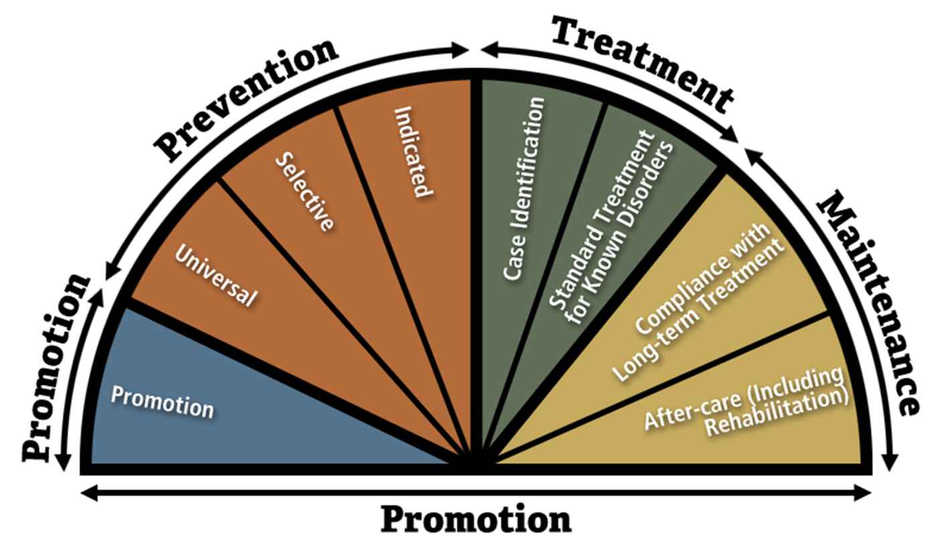
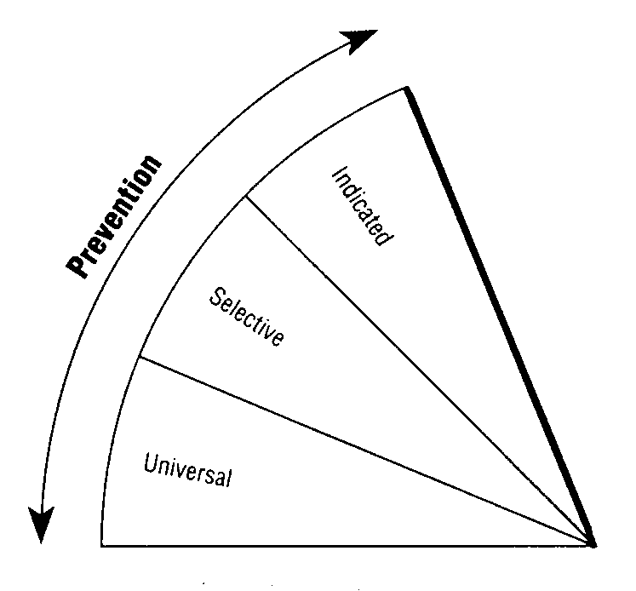
Care Continuum and Strategies
Institute of Medicine Continuum of Care
Intervention Strategies
Information Dissemination
  Raise awareness regarding substance use and available substance use services
Education
  Two-way information exchange with At-risk Populations
Problem Identification & Referral
  Identifying At-risk Populations that have initiated substance use that would benefit from SUD Prevention services
Community Based Process
  Increasing the capacity of communities to provide substance use prevention services
Alternatives
  Involve risk free socialization environments
Environmental
  Changing community standards, code and policies to reduce availability of intoxicating substances

Slide 58
Demographics FY12/13 – FY 15/16

Slide 59
Demographics FY12/13 – FY 15/16

Slide 60
Substance Use Prevention Services Focus for
July 1, 2015 – June 30, 2020
Madera’s New Approach
Past approaches – Low Impact
New initiative - focused on capacity building for community wide substance use prevention
A grassroots community wide effort to reduce youth substance use and abuse.
High Rate of Teen Substance Use (Esp. Alcohol)
  Goal: Reduce Alcohol Use in Middle & High School Teens
  Approach: Community-Based Process Strategy for Middle School and High School Teens to Increase Capacity to Reduce High Rates of Substance Use

Slide 61
Substance Use Risk Factors

Slide 62
Substance Use Funding Amounts by Category FY 15-16 & 16/17
FY 16/17 Total = $1,708,484 (1% increase from FY 15/16)

Slide 63
Please rank and rate survey options.
1, 2, 3 … or
a, b, c

Slide 64
Come to a Planning Meeting
Stakeholder Meeting Dates for 2018
Madera County Libraries
April 5th Madera Library 1pm - 3pm
April 10th Chowchilla Library 3pm - 5pm
April 12th Madera Ranchos Library 1pm - 3pm
April13th North Fork Library 1pm - 3pm
April19th Oakhurst Library 1:30pm – 3:30 pm

Slide 65
Please visit our website at
http://www.madera-county.com/index.php/bhsoverview
Please take our survey regarding planning and services
Please let us know if you would like to be involved
For further information contact David Weikel at
  (559) 673-3508
  Email: david.weikel@co.mader.ca.gov

Slide 66
Thank you for your time and interest in improving mental health and substance abuse services to Madera County residents

