Slide 1
MENTAL HEALTH PLAN / PLAN DE SALUD MENTAL
ORGANIZATIONAL/RENDERING PROVIDER DIRECTORY DIRECTORIO DE PROVEEDORES EXISTENTES/ORGANIZACIONALES
For Mental Health Services call the Access Line at (559) 673-3508 or (888) 275-9779 or 311 for TTY Users Para Servicios de Salud Mental llame a la línea de acceso at (559) 673-3508 o (888) 275-9779 o 711 para usuarios de TTY
Revision Date: September 2022 / Fecha de Revisión: Septiembre 2022
Template Rvsd: 21 1231

Slide 2
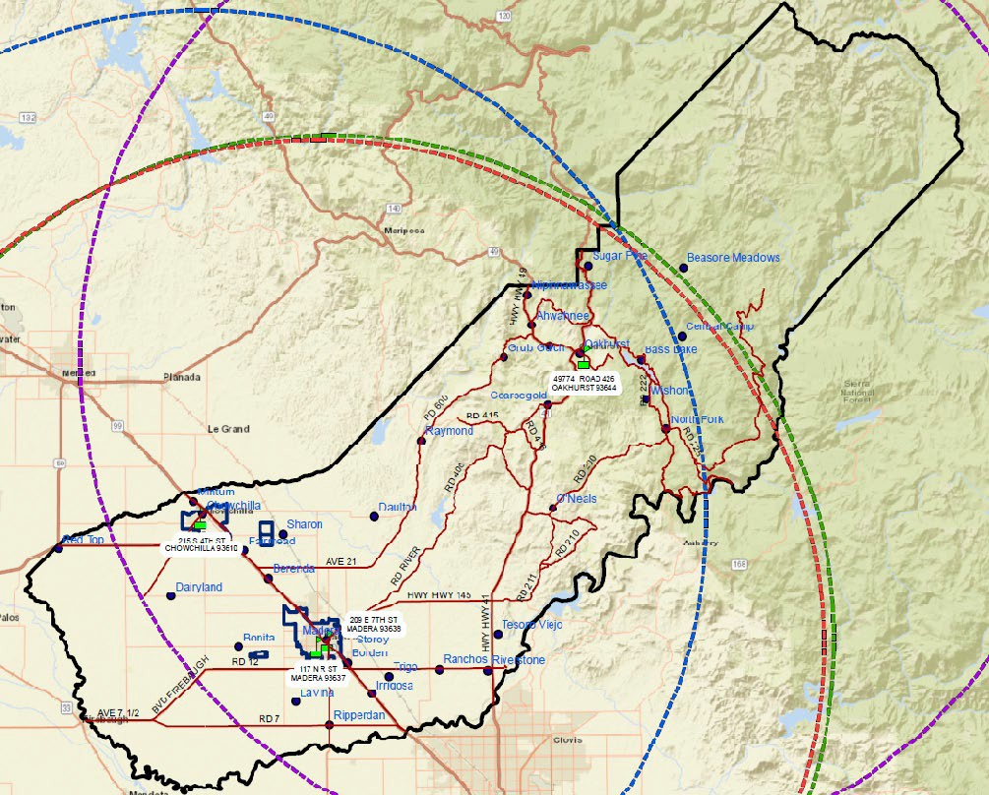
Service Area & Site Locations Area de Servicio e Ubicaciones

Slide 3
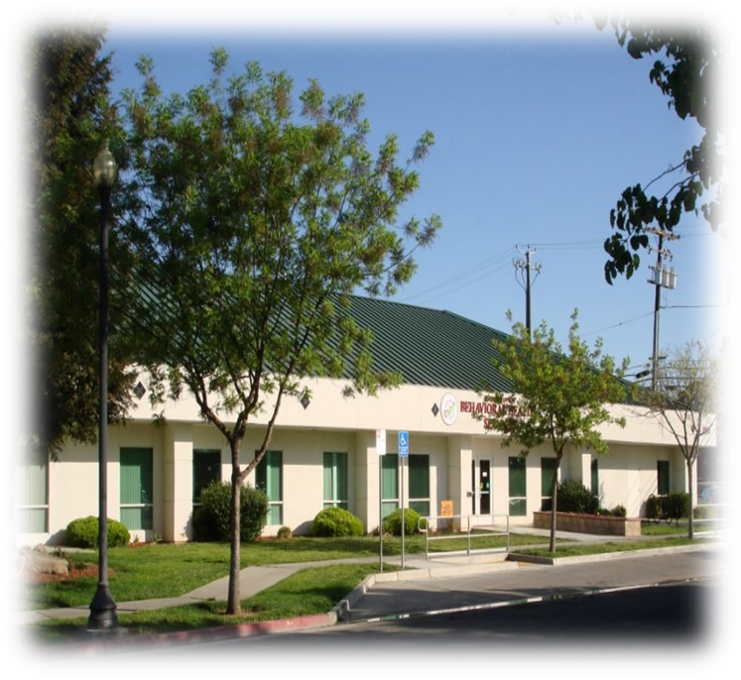
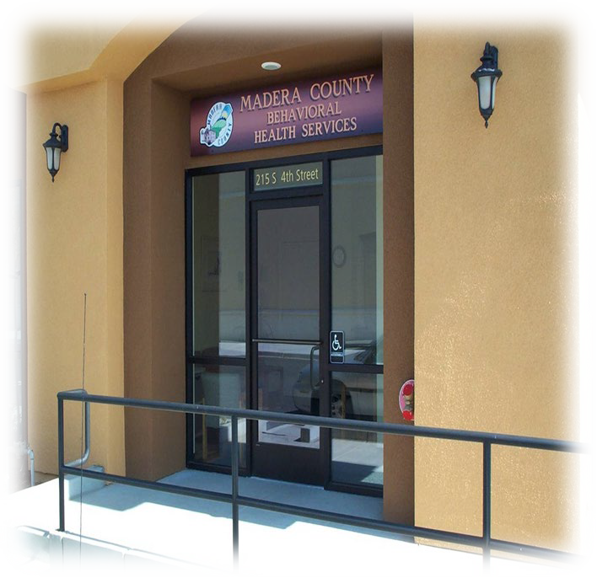
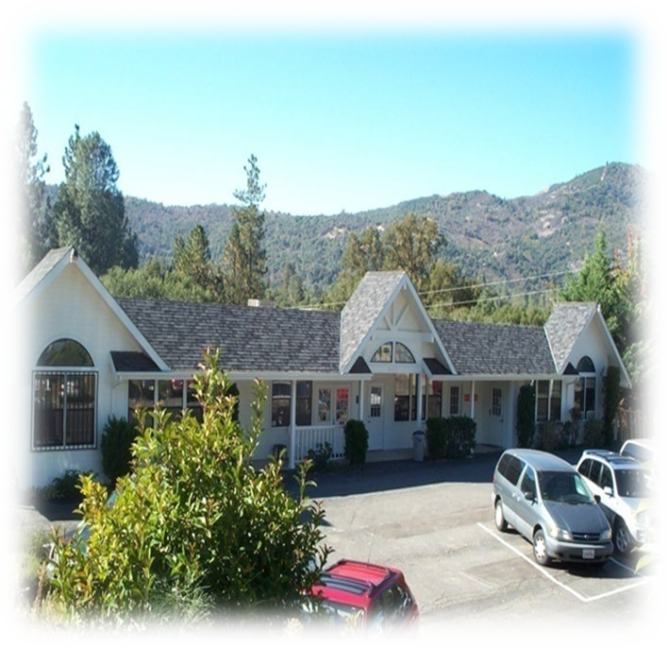
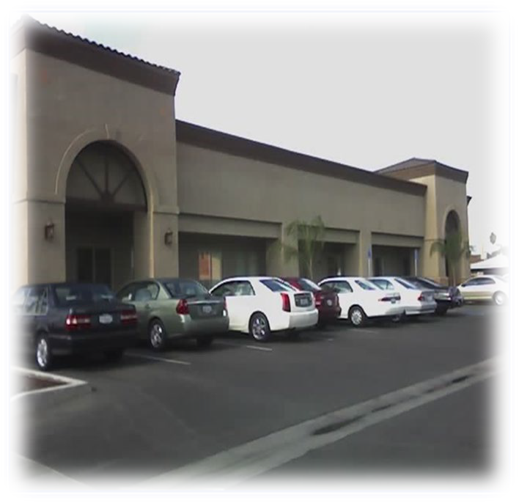
Behavioral Health Services Locations Ubicaciones de Servicios de Salud Mental
We provide services at 4 different locations throughout the county.
Ofrecemos servicios en 4 ubicaciones del condado.
Behavioral Health Services
209 E. 7th Street Madera, Ca
Chowchilla Recovery Center 215 S. 4th Street Chowchilla, Ca
Oakhurst Counseling Center Pine Recovery Center
49774 Rd 426, Suite D
Oakhurst, Ca
117 N. R Street, Madera, Ca

Slide 4
Welcome to the Madera County Medi-Cal Mental Health Plan (MHP) Provider Directory. Madera County Department of Behavioral Health administers specialty mental health services to children, youth, transitional age youth (TAY), adults and older adults who live in Madera County. This Provider Directory provides information on all mental health treatment providers that are part of the County's network of care. Some of the services and providers listed require authorization or referral from the County before the service can be provided. The Department of Behavioral Health Services Access Program can help you determine what provider may be best for you or a family member.
Services may be delivered by an individual provider, or a team of providers, and may be an unlicensed provider who is working under the direction of a licensed practitioner, operating within their scope of practice. Only licensed, waivered, or registered mental health providers are listed in this Provider Directory.
Madera County Behavioral Health Services 209 E. 7th Street, Madera, CA 93638 Access Line: (559) 673-3508
About BHS | Madera County
This directory is available online: Services Provider and Network Provider Lists | Madera County & paper copies of this directory are available, free of charge, within 5 business days from request.

Slide 5
Bienvenido al Directorio de Proveedores del Plan de Salud Mental de Medi-Cal del Condado de Madera. El Departamento de Salud Mental del Condado de Madera administra servicios especializados de salud mental para niños, jovenes, menores en edad de transición, adultos y adultos mayores que viven en el Condado de Madera. Este Directorio de Proveedores proporciona información sobre todos los proveedores de salud mental dentro de la red de servicio del Condado. Algunos de los servicios y proveedores enumerados requieren autorización o referencia del Condado antes de que los servicios sean proporcionados. El Departamento de Salud Mental le puede ayudar a determinar cual proveedor podría ser mejor para usted o su miembro de familia.
Los servicios pueden ser provistos por un proveedor individual, o por un equipo de proveedores, y puede ser un proveedor sin licencia que está trabajando bajo la dirección de un profesional licenciado, que opera dentro del alcance de su práctica. Sólo los proveedores de salud mental licenciados, exceptuados o registrados aparecen en este Directorio de Proveedores.
Servicios de Salud Mental del Condado de Madera 209 E. 7th Street, Madera, CA 93638
Línea de Acceso: (559) 673-3508 Sobre Salud Mental | Condado de Madera
Este directorio esta disponible el línea: Lista de Proveedores de Servicio | Condado de Madera & copias impresas están disponibles, sin cargo alguno, dentro de 5 días hábiles al solicitarla.

Slide 6
If you need this notice and/or other documents from the Plan in an alternative communication format such as Braille, or an electronic format, or, if you would like Help Reading or would like to request auxiliary aids and services, please contact the Mental Health Plan by calling (559) 673-3508.
You have the right to free language assistance services, please let one of agency staff know if you require them.
Our facilities have accommodations for people with physical disabilities, including offices, exam room(s) and equipment. We are committed to providing, available, appropriate and accessible services.
Si usted requiere este aviso y/u otros documentos del Plan en un formato de comunicación alterno como, Braille, o formato electrónico, o si desea ayuda en leer el material o servicios auxiliares por favor contacte al Plan de Salud Mental al llamar al (559) 673-3508.
Tiene el derecho a servicios de asistencia de lenguaje gratuitos, por favor avise a nuestro personal si los requiere.
Nuestras instalaciones son accesibles para personas con discapacidad en sus oficinas, cuartos de examinación, y equipo. Nos comprometemos a proporcionar, servicios disponibles, apropiados y accesibles.

Slide 7
LANGUAGE ASSISTANCE / ASISTENCIA LINGÜÍSTICA
English
ATTENTION: If you speak another language, language assistance services, free of charge, are available to you. Call 1-559-673-3508 (TTY: 1-800-735-2929).
ATTENTION: Auxiliary aids and services, including but not limited to large print documents
and alternative formats, are available to you free of charge upon request. Call 1-559-673-
3508 (TTY: 1-800-735-2929).
Español (Spanish)
ATENCIÓN: Si habla español, tiene a su disposición servicios gratuitos de asistencia lingüística. Llame al 1-559-673-3508 (TTY: 1-800-
735-2929).
Tiếng Việt (Vietnamese)
CHÚ Ý: Nếu bạn nói Tiếng Việt, có các dịch vụ hỗ trợ ngôn ngữ miễn phí dành cho bạn. Gọi số 1-559-673-3508 (TTY: 1-800-735-
2929).
Tagalog (Tagalog ̶ Filipino)
PAUNAWA: Kung nagsasalita ka ng Tagalog, maaari kang gumamit ng mga serbisyo ng tulong sa wika nang walang bayad. Tumawag
sa 1-559-673-3508 (TTY: 1-800-735-2929).
한국어 (Korean)
주의: 한국어를 사용하시는 경우, 언어 지원 서비스를 무료로 이용하실 수 있습니다. 1-559-673-3508 (TTY: 1-800-735-2929) 번으로 전화해 주십시오.
繁體中文(Chinese)
注意：如果您使用繁體中文，您可以免費獲得語言援助服務。請致電 1-559-673-3508 (TTY: 1-800-735-2929)。
Հ այ ե ր ե ն (Armenian)
ՈՒՇԱԴՐՈՒԹՅ ՈՒՆ՝ Եթե խո ս ո ւ մ եք հ այ ե ր ե ն , ապա ձեզ ան վ ճ ար կ ար ո ղ են տր ամ ադ ր վ ե լ լ ե զ վ ակ ան աջ ակ ց ո ւ թյ ան ծ առ այ ո ւ թյ ո ւ ն ն ե ր : Զան գ ահ ար ե ք 1-559-673-3508 (TTY: 1-800-735-2929).

Slide 8
LANGUAGE ASSISTANCE / ASISTENCIA LINGÜÍSTICA
Русский (Russian) ВНИМАНИЕ: Если вы говорите на русском языке, то вам доступны бесплатные услуги перевода. Звоните 1- 559-673-3508 (TTY: 1-800-735-2929).
ﯽﺳرﺎﻓ (Farsi)
日本語 (Japanese)
注意事項：日本語を話される場合、無料の言語支援をご利用いただけます。1-559-673-3508 (TTY: 1-800-735-2929) まで、お電話にてご連絡ください。
Hmoob (Hmong)
LUS CEEV: Yog tias koj hais lus Hmoob, cov kev pab txog lus, muaj kev pab dawb rau koj. 2929).
Hu rau 1-559-673-3508 (TTY: 1-800-735-
ਪੰਜਾਬੀ (Punjabi)
ਿਧਆਨ ਿਧਓ: ਜੇ ਤੁਸ ◌ੀ◌ਂਪੰਜਾਬ ਬੋਿਲੇ ਹੋ, ਤਾੀ ਂ ਭਾਸ਼ਾ ਧ ਿ◌◌ੱਚ ਸਹਾਇਤਾ ਸੇ ◌ਾ ਤੁਹਾਡੇ ਲਈ ਮੁਫਤ ਉਪਲਿਬ ਹੈ। 1-559-673-3508 (TTY: 1-800-735-2929) 'ਤੇ ਕਾਲ ਕਰੋ।
िहंदी (Hindi)
�ान द�: यिद आप िहंदी बोलते ह� तो आपके िलए मु� म� भाषा सहायता सेवाएं उपल� ह�। [1-559-673-3508 (TTY: 1-800-735-2929) पर कॉल कर�।
ŕ ΘŮΘ→Ŀ ř (Thai)
ⁿŚδřŃ: ľ Θ∟čĹτ ő φĺ ŕ ΘŮΘ→Ŀř čĹτ ůΘŘΘŚľ ↑Ąń∟ŚĆαΘŚĄ↨Ťř ⁿŰŢσŹĿΘ·ŕ ΘŮΘ→ĺ Ŕ∟Śδ←ĿŚ1-559-673-3508 (TTY: 1-800-735-2929).

Slide 9
LANGUAGE ASSISTANCE / ASISTENCIA LINGÜÍSTICA

Slide 10
COUNTY OFFICE LOCATIONS / UBICACIONES DE OFICINAS DEL CONDADO
Prior authorization is required for outpatient, non-emergency services. Please contact the Access Line at (559) 673-3508 or toll free at 1-888-275-9779 for availability, accommodation needs and referral to the listed providers.
Deaf and hard of hearing individuals may contact the Appointment Line by TTY/TDD at (800) 735-2929 or California Relay 711.
All providers are required to attend annual County provided and/or equivalent cultural competence training as part of their agreement to provide services through Madera County Mental Health Plan.
Se requiere autorización previa para servicios sin cita previa y que no sean de emergencia.
Por favor contacte a la Línea de Citas al (559) 673-3508 o al número gratuito 1-888-275- 9779 para disponibilidad, necesidades de acceso y para ser referido a los proveedores indicados en esta lista.
Individuos sordos o que tengan dificultad al oír pueden llamar a la línea TTY/TDD al (800) 735-2929 o marque el 711 para servicios de retransmisión (Relay).
Se le requiere a todos los proveedores asistir a entrenamiento de competencia cultural anualmente y/o entrenamiento equivalente como parte de éste acuerdo para proveer servicios por medio del Plan de Salud Mental (MHP) del Condado de Madera.

Slide 11
LIST OF ACRONYMS
DDX - Dual Diagnosis/Diagnosis Dual
AS - Abuse Survivors/Sobrevivientes de Abuso
AD - Adjustment Disorders/Trastorno de Adaptación
ADP - Adoption/Adopción
A - Adults/Adultos
HIV - AIDS and HIV Positive/SIDA y VIH Positivo
ANXD - Anxiety Disorders/Trastorno de Ansiedad
ADHD - Attention-Deficit/Déficit de Atención
C – Children/Niños
CC0-5 - Caregivers of children 0-5/Cuidadores de Niños 0-5
CA - Conserved Adults/Adultos con Albacea
DD - Developmentally Delayed/Retraso de Desarrollo
DI - Disorders of Infancy/Trastorno de Infancia
DC - Disorders of Childhood/Trastorno de Niñez
DA - Disorders of Adolescence/Trastorno de Adolescencia
DSD - Dissociative Disorders/Trastorno Disociativo
DVP - Domestic Violence Perpetrators/Agresores de Violencia Domestica
DVV - Domestic Violence Victims/Víctimas de Violencia Domestica
PSYD - Psychotic
ED - Eating Disorders/Trastorno Alimenticio
Disorders/Trastorno Psicótico
ECEA - Elder Care/Elder Abuse/Cuidado/Abuso de •SPMI – Severe Persistent
Adultos Mayores
FT - Family Therapy/Terapia Familiar
F – Forensic/Forense
FY - Foster Youth/Jóvenes de Crianza
GM - Gang Members/Pandilleros
GID - Gender Identity Disorders/Trastorno de Identidad de Género
GB - Grief/Bereavement/Dolor/Perdida
GT - Group Therapy/Terapia en Grupo
H – Homeless/Personas sin Hogar
IS – Interpreter Services/Servicios de Interpretación
LGBTQQIA
MI - Mobility Impaired/Trastorno de Movilidad
MD - Mood Disorders/Trastorno de Humor
NA - Native American/Americano Nativo
OA - Older Adults/Adultos Mayores
P – Perinatal/Perinatal
Mental illness/Enfermedad
Mental Severa y Persistente
SO - Sex Offenders/Agresor
Sexual
SAV - Sexual Abuse Victims/ Victimas de Abuso Sexual
SR – Special Referral
/Referencia Especial
SS – Spanish
Speaking/Hispanohablantes
V – Veterans/Veteranos
VI - Visually
Impaired/Trastorno Visual
Y –Youth/Jóvenes
PD - Personality Disorders/Trastorno de Personalidad

Slide 12
COUNTY OFFICE LOCATIONS / UBICACIONES DE OFICINAS DEL CONDADO
MADERA COUNTY BEHAVIORAL HEALTH SERVICES
209 E. 7TH STREET, MADERA, CA 93638
Phone: (559) 673-3508 Fax: (559) 661-2818
24/7 Toll Free Line: (888) 275-9779
TTY/TDD: (800) 735-2929 or 711
Hours of Operation: 8:00am - 5:00pm Monday-Friday
SERVICIOS DE SALUD MENTAL DEL CONDADO DE MADERA
209 E 7TH STREET, MADERA, CA 93638
Teléfono: (559) 673-3508 Fax: (559) 661-2818
Línea gratuita de 24 horas/7 días: (888) 275-9779
TTY/TDD: (800) 735-2929 o 711
Horas de Operación: 8:00am – 5:00pm lunes-viernes

Slide 13
Provider / Proveedor | NPI #/ # NPI | License/ Licencia | License #/ # de Licencia | Specialty/ Especialidad | Population Served/ Población | Linguistic Capability/Aptitud Lingüística | Cultural Capability /Aptitud Cultural | Cultural Competency Training/ Educación | Accepting Clients/ Acepta Clientes
Carter, Theresa | 1164858932 | ACSW | 107082 | A,Y,OA | A,Y,OA | Patois | A,Y,OA | Yes/Si | SR
Casillas, Kathleen | 1457575953 | LMFT | 108277 | C | C | Spanish/Español | C | Yes/Si | SR
Chan, David | 1598006256 | CADC1 | Ci21410219 | A | A | Spanish/Español | A | Yes/Si | SR
Colbert, Joan | 1225424997 | AMFT | 113441 | A | A | IS | A | Yes/Si | SR
DeLaFuente, Gilbert | 1376901587 | SUDCC | 6322 | A | A | IS | A | Yes/Si | SR
Duarte, Ewan | 1912635293 | ACSW | 97231 | A, SPMI | A, SPMI | IS | A, SPMI | Yes/Si | SR
Garcia, Araceli | 1457869661 | SUDCC | 7703 | A | A | Spanish/Español | A | Yes/Si | SR
Gill, Swaranjit | 1669536421 | NP | 15071 | Y, A,OA | Y,A, OA | Hindi, Punjabi | Y, A,OA | Yes/Si | SR
Gonzalez, Juan | 1033770367 | APCC | 6611 | A, H, VI | A, H, VI | Spanish/Español | A, H, VI | Yes/Si | SR
Hurtado, Sandra | 1538558721 | LMFT | 105664 | C,Y,A | C,Y,A | Spanish/Español | C,Y,A | Yes/Si | SR
Juarez, Valentin | 1659987972 | ACSW | 105333 | A, H, VI | A, H, VI | Spanish/Español | A, H, VI | Yes/Si | SR
Martinez, Maria | 1992294060 | AMFT | 119559 | A,OA,H | A,OA,H | Spanish/Español | A,OA,H | Yes/Si | SR
Mora, Griselda | 1619667037 | AMFT | 113439 | A,OA,H | A,OA,H | Spanish/Español | A,OA,H | Yes/Si | SR
Munoz, Margarita | 1083228431 | ACSW | 96377 | AS, AD, GT | A, LGBTQQIA | Spanish/Español | A, LGBTQQIA | Yes/Si | SR

Slide 14
Provider / Proveedor | NPI #/ # NPI | License/ Licencia | License #/ # de Licencia | Specialty/ Especialidad | Population Served/ Población | Linguistic Capability/Aptitud Lingüística | Cultural Capability/Aptitud Cultural | Cultural Competency Training/ Educación | Accepting Clients/ Acepta Clientes
Nuzzolese, Robert | 1689074700 | AMFT | 111516 | OA, SR | OA, SR | IS | OA, SR | Yes/Si | SR
Oliver, Barney | 1902087877 | LMFT | 46798 | A | A | IS | A | Yes/Si | SR
Ortega, Annette | 1972925469 | SUDCC | 9137 | A | A | IS | A | Yes/Si | SR
Ramos, Esperanza | 1376246686 | ACSW | 113415 | A, H, VI | A, H, VI | Spanish/Español | A, H, VI | Yes/Si | SR
Rollins, Taylor | 1407533037 | APCC | 13546 | A, H, VI | A, H, VI | IS | A, H, VI | Yes/Si | SR
Sanchez, Ditania | 1174076889 | SUDCC | C041290317 | A | A | Spanish/Español | A | Yes/Si | SR
Turner, Willie | 1427440205 | SUDCC | 6496 | A | A | IS | A | Yes/Si | SR
Wade, Moya | 1376190223 | ACSW | 98131 | C, Y, A, OA | C, Y, A, OA | IS | C, Y, A | Yes/Si | SR
Wingfield, Shanell | 1154748689 | LMFT | 117425 | A | A | IS | A | Yes/Si | SR

Slide 15
COUNTY OFFICE LOCATIONS / UBICACIONES DE OFICINAS DEL CONDADO
CHOWCHILLA RECOVERY CENTER (CRC)
215 S. 4th Street, Chowchilla, CA 93610
Phone: (559) 665-2947 Fax: (559) 665-4906
24/7 Toll Free Line: (888) 275-9779
TTY/TDD: (800) 735-2929 or 711
Hours of Operation: 8:00am - 5:00pm Monday-Friday
CENTRO DE RECUPERACIÓN CHOWCHILLA (CRC)
215 S. 4th Street, Chowchilla, CA 93610
Teléfono: (559) 665-2947 Fax: (559) 665-4906
Línea gratuita de 24 horas/7 días: (888) 275-9779
TTY/TDD: (800) 735-2929 o 711
Horas de Operación: 8:00am – 5:00pm lunes-viernes

Slide 16
Provider / Proveedor | NPI #/ # NPI | License/ Licencia | License #/ # de Licencia | Specialty/ Especialidad | Population Served/ Población | Linguistic Capability/Aptitud Lingüística | Cultural Capability/ Aptitud Cultural | Cultural Competency Training/ Educación | Accepting Clients/ Acepta Clientes
Becker-Denney, Terri | 1053534438 | LMFT | 79271 | C,Y,A | C,Y,A | IS | C,Y,A | Yes/Si | SR
Lemus, Carolina | 1326449562 | LMFT | 125595 | C,Y,A | C,Y,A | IS | C,Y,A | Yes/Si | SR
Martinez, Victoria | 1407044720 | AMFT | 134765 | AD, DVV | A, FY, SAV | Spanish/Español | A, FY,SAV | Yes/Si | SR
Qasem, Esther | 1417210162 | AMFT | 121232 | A | A | Hindi | A | Yes/Si | SR

Slide 17
COUNTY OFFICE LOCATIONS / UBICACIONES DE OFICINAS DEL CONDADO
OAKHURST COUNSELING CENTER (OCC)
49774 RD. 426, Suite D, Oakhurst, CA 93644
Phone: (559) 683-4809 Fax: (559) 683-6499
24/7 Toll Free Line: (888) 275-9779
TTY/TDD: (800) 735-2929 or 711
Hours of Operation: 8:00am - 5:00pm Monday-Friday
CENTRO DE CONSEJERÍA OAKHURST (OCC)
49774 RD. 426, Suite D, Oakhurst, CA 93644
Teléfono: (559) 683-4809 Fax: (559) 683-6499
Línea gratuita de 24 horas/7 días: (888) 275-9779
TTY/TDD: (800) 735-2929 o 711
Horas de Operación: 8:00am – 5:00pm lunes-viernes

Slide 18
Provider / Proveedor | NPI #/ # NPI | License/ Licencia | License #/ # de Licencia | Specialty/ Especialidad | Population Served/ Población | Linguistic Capability/Aptitud Lingüística | Cultural Capability/ Aptitud Cultural | Cultural Competency Training/ Educación | Acceptin Clients/ Acepta Clientes
Agayan, Mariam | 1396861258 | LMFT | 52186 | A, DDX, F | A, DDX, F | Armenian/Armenia | A, DDX, F | Yes/Si | SR
Baltuth, Aziza | 1811646722 | ACSW | 106158 | A,C,Y,OA | A,C,Y,OA | IS | A,C,Y,OA | Yes/Si | SR
Kubal, Victoria | 1346547866 | LMFT | 97693 | C,Y,A | C,Y,A | IS | C,Y,A | Yes/Si | SR
Navarro, John | 1851801039 | SUDCC | 9379 | A | A | IS | A | Yes/Si | SR
Strimling, Diana | 1194224188 | AMFT | 104452 | AS, ANXD, DC, DA, DVV, | AS, ANXD, DC, DA, DVV | IS | AS, ANXD, DC, DA, DVV | Yes/Si | SR

Slide 19
COUNTY OFFICE LOCATIONS / UBICACIONES DE OFICINAS DEL CONDADO
Children, Youth and Family Recovery Center
117 N. R. STREET, SUITE 101, MADERA, CA 93637
Phone: (559) 662-0527 Fax: (559) 661-5159
24/7 Toll Free Line: (888) 275-9779
TTY/TDD: (800) 735-2929 or 711
Hours of Operation: 8:00am - 5:00pm Monday-Friday
Centro de Recuperación para Niños, Jóvenes y Familias117 N. R. STREET, SUITE 101, MADERA, CA 93637
Teléfono: (559) 662-0527 Fax: (559) 661-5159
Línea gratuita de 24 horas/7 días: (888) 275-9779
TTY/TDD: (800) 735-2929 o 711
Horas de Operación: 8:00am – 5:00pm lunes-viernes

Slide 20
Provider / Proveedor | NPI #/ # NPI | License/ Licencia | License # / # de Licencia | Specialty/ Especialidad | Population Served/ Población | Linguistic Capability/Aptitud Lingüística | Cultural Capability/ Aptitud Cultural | Cultural Competency Training/ Educación | Accepting Clients/ Acepta Clientes
Carreno, Seneca | 1447916325 | AMFT | 129048 | AS, AD, GT | SAV, Y | Spanish/Español | SAV, Y | Yes/Si | SR
Casillas, Kathleen | 1457575953 | LMFT | 108277 | C | C | Spanish/Español | C | Yes/Si | SR
Chapman, Valerie | 1376945667 | AMFT | 130342 | CC0-5,C | CC0-5,C | IS | CC0-5,C | Yes/Si | SR
Espinoza, Hilda | 1295852408 | LMFT | 88805 | C, Y | C, Y | Spanish/Español | C, Y | Yes/Si | SR
Ferguson, Sheryle | 1316163801 | LMFT | 44104 | C,Y,A | C,Y,A | IS | C,Y,A | Yes/Si | SR
Griggs, Baylee | 1194177873 | LMFT | 130859 | CC0-5,C | CC0-5,C | IS | CC0-5,C | Yes/Si | SR
Laird, Laura | 1548691264 | LMFT | 128388 | C,Y,A | C,Y,A | Spanish/Español | C,Y,A | Yes/Si | SR
Magana, Erick | 1942657119 | AMFT | 128310 | C,Y,A | C,Y,A | Spanish/Español | C,Y,A | Yes/Si | SR
Orozco, Carolina | 1619578226 | APCC | 8849 | C | C | IS | C | Yes/Si | SR
Salazar, Cynthia | 1801519327 | APCC | 12900 | FY, GB, Y | SAV, Y | IS | SAV, Y, GB | Yes/Si | SR
Vasquez, Frances | 1689829319 | AMFT | 112874 | Y | Y | Spanish/Español | Y | Yes/Si | SR

Slide 21
INDIVIDUAL NETWORK PROVIDERS / PROVEEDORES DE RED INDIVIDUALES CONTRACT / CONTRATO
Rex Adamson, M.D. 1878 E. Hatch Road Modesto, Ca 95351
(209) 538-1496
www.davisguesthome.com
Lynn Bertram M.D.
209 E. 7th Street Madera, Ca 93637
(559) 673-3508
www.maderacounty.com
Ramon Raypon, M.D.
209 E. 7th Street Madera, Ca 93637
(559) 673-3508
www.maderacounty.com

Slide 22
Provider / Proveedor | NPI #/ # NPI | License/ Licencia | License #/ # de Licencia | Specialty/ Especialidad | Population Served/ Población | Linguistic/ Cultural Capability Aptitud Lingüística/Cultural | Cultural Competency Training/ Educación | Accepting Clients/ Acepta Clientes
Adamson, Rex | 1053416701 | MD | G85915 | IT, MS, SMHS | A | Spanish/Español, IS | Yes/Si | SR
Bertram, Lynn | 1770549131 | MD | 650679 | IT, MS, SMHS | A | IS | Yes/Si | SR
Ramon, Raypon | 1992814610 | MD | A39769 | IT, MS, SMHS | A | Spanish/Español, IS | Yes/Si | SR

Slide 23
GROUP NETWORK PROVIDERS / PROVEEDORES DE RED DE GRUPO CONTRACT / CONTRATO
Bio-Behavioral Medical Clinics, Inc.** (Inpatient Only)
1060 West Sierra Ste. 105
Fresno 93711
(559) 437-1111
www.bbmc-inc.com

Slide 24
Provider / Proveedor | NPI #/ # NPI | License/ Licencia | License #/ # de Licencia | Specialty/ Especialidad | Population Served/ Población | Capability Aptitud Lingüística/Cultural | Competency Training/ Educación | Clients/ Acepta Clientes
Adapa, Indira | 1588776918 | MD | A86927 | Y,A,OA | Y,A,OA | Spanish/Español, IS | Yes/Si | SR
Badhesha, Upkar | 1285171751 | NP | 95007691 | Y,A,OA | Y,A,OA | Spanish/Español, IS | Yes/Si | SR
Castillo, Manolito | 1962585356 | MD | A67937 | Y,A,OA | Y,A,OA | Spanish/Español, IS | Yes/Si | SR
Dhaliwal, Jaberpreet S. | 1396372629 | MD | 19518 | Y,A,OA | Y,A,OA | Spanish/Español, IS | Yes/Si | SR
Go Ting, Mark Bryan | 1588925861 | MD | A131596 | Y,A,OA | Y,A,OA | Spanish/Español, IS | Yes/Si | SR
Hanes, Natalie | 1699145862 | NP | 95002639 | Y,A,OA | Y,A,OA | Spanish/Español, IS | Yes/Si | SR
Hussain, Parveen | 1811524044 | MD | 20A19402 | Y,A,OA | Y,A,OA | Spanish/Español, IS | Yes/Si | SR
Kaur, Manvinder | 1508226903 | NP | 95005135 | Y,A,OA | Y,A,OA | Spanish/Español, IS | Yes/Si | SR
Litiema, Cecil | 1609908423 | NP | 14147 | Y,A,OA | Y,A,OA | Spanish/Español, IS | Yes/Si | SR
Lo, Hope | 1881175891 | NP | 95009673 | Y,A,OA | Y,A,OA | Spanish/Español, IS | Yes/Si | SR
Moua, Ger | 1023591229 | NP | 95009951 | Y,A,OA | Y,A,OA | Spanish/Español, IS | Yes/Si | SR
Peng, Sean | 1265826812 | NP | 95004053 | Y,A,OA | Y,A,OA | Spanish/Español, IS | Yes/Si | SR
Roque, Roman Christopher | 1992333413 | MD | 19417 | Y,A,OA | Y,A,OA | Spanish/Español, IS | Yes/Si | SR
Steinbach, Kenneth | 1821100173 | MD | A43021 | Y,A,OA | Y,A,OA | Spanish/Español, IS | Yes/Si | SR
Vydro, Aleksandr | 1124130430 | MD | A54990 | Y,A,OA | Y,A,OA | Spanish/Español, IS | Yes/Si | SR
Yuen, Lilianna | 1477059798 | MD | A167332 | Y,A,OA | Y,A,OA | Spanish/Español, IS | Yes/Si | SR

Slide 25
GROUP NETWORK PROVIDERS / PROVEEDORES DE RED DE GRUPO CONTRACT / CONTRATO
JDT Consultants (TBS/IHBS Only)
4205 W. Figarden Drive Fresno, Ca 93722
(559) 790-2662
www.jdtconsultant.com

Slide 26
Provider / Proveedor | NPI #/ # NPI | License/ Licencia | License #/ # de Licencia | Specialty/ Especialidad | Population Served/ Población | Capability Aptitud Lingüística/Cultural | Competency Training/ Educación | Clients/ Acepta Clientes
Amancio, Isabel | 1194868695 | LMFT | 39580 | C,Y | C,Y | Spanish/Español, IS | Yes/Si | SR
Bachicha, Christina | 1356463947 | LCSW | 74446 | C,Y | C,Y | Spanish/Español, IS | Yes/Si | SR
Bazan, Marlene | 1710137955 | LMFT | 107388 | C,Y | C,Y | Spanish/Español, IS | Yes/Si | SR
Cardenas, Jamie | 1720585102 | LMFT | 123493 | C,Y | C,Y | Spanish/Español, IS | Yes/Si | SR
Damo, Ashley | 1346676756 | LMFT | 123429 | C,Y | C,Y | Spanish/Español, IS | Yes/Si | SR
Del Cid, Rosa | 1285969360 | LCSW | 21203 | C,Y | C,Y | Spanish/Español, IS | Yes/Si | SR
Lara, Mary Cruz | 1215154414 | ACSW | 76530 | C,Y | C,Y | Spanish/Español, IS | Yes/Si | SR
McCarty, Julia | 1467922831 | APCC | 8043 | C,Y | C,Y | Spanish/Español, IS | Yes/Si | SR
Nelson, Chad | 1598165953 | LMFT | 114849 | C,Y | C,Y | Spanish/Español, IS | Yes/Si | SR
Rodriguez, J Felix | 1518097898 | LMFT | 106370 | C,Y | C,Y | Spanish/Español, IS | Yes/Si | SR
Todd, Jana | 1215007281 | LCSW | 16669 | C,Y | C,Y | Spanish/Español, IS | Yes/Si | SR

Slide 27
GROUP NETWORK PROVIDERS / PROVEEDORES DE RED DE GRUPO CONTRACT / CONTRATO
American Telepsychiatrists
3308 El Camino Ave Ste 300-136
Sacramento, Ca 95821 www.atpsnetwork.com

Slide 28
Provider / Proveedor | NPI #/ # NPI | License/ Licencia | License #/ # de Licencia | Specialty/ Especialidad | Population Served/ Población | Linguistic/ Cultural Capability Aptitud Lingüística/Cultural | Cultural Competency Training/ Educación | Accepting Clients/ Acepta Clientes
Jayaraman, Caaithiry | 1598918575 | MD | A115944 | IT, MS, SMHS | A | IS | Yes/Si | SR
Schaeffer, John | 1497743918 | MD | 9536 | IT, MS, SMHS | A | IS | Yes/Si | SR

Slide 29
GROUP NETWORK PROVIDERS / PROVEEDORES DE RED DE GRUPO CONTRACT / CONTRATO
Iris Telehealth
1944 East Pembroke Ave Ste A Hampton, VA 23663
(888) 285-2269
www.iristelehealth.com

Slide 30
Provider / Proveedor | NPI #/ # NPI | License/ Licencia | License #/ # de Licencia | Specialty/ Especialidad | Population Served/ Población | Linguistic/ Cultural Capability Aptitud Lingüística/Cultural | Cultural Competency Training/ Educación | Accepting Clients/ Acepta Clientes
Cordova-Gonzalez, Maria | 1710295423 | MD | 166630 | IT, MS, SMHS | A | IS | Yes/Si | SR
Hall, Stephanie | 1841406154 | MD | G163367 | IT, MS, SMHS | Y | IS | Yes/Si | SR
Rodriguez-Delgado, Iris | 1730243981 | MD | C158512 | IT, MS, SMHS | Y | IS | Yes/Si | SR

Slide 31
GROUP NETWORK PROVIDERS / PROVEEDORES DE RED DE GRUPO CONTRACT / CONTRATO
Westcare Crisis Services 4944 E. Clinton
Fresno, Ca 93776
(559) 237-3420
www.westcare.com

Slide 32
Provider / Proveedor | NPI #/ # NPI | License/ Licencia | License #/ # de Licencia | Specialty/ Especialidad | Population Served/ Población | Linguistic/ Cultural Capability Aptitud Lingüística/Cultural | Cultural Competency Training/ Educación | Accepting Clients/ Acepta Clientes
Alejandro, Cheree | 1356795587 | LPCC | 10092 | Crisis Services | Y, A, OA | IS | Yes/Si | SR
Brambila, Marisol | 1477006997 | APCC | 6841 | Crisis Services | Y, A, OA | Spanish/Español | Yes/Si | SR
Debenedetto, Yelena | 1750550828 | LMFT | 50437 | Crisis Services | Y, A, OA | IS | Yes/Si | SR
Jordan-Church, Mary | 1336471630 | LCSW | 24068 | Crisis Services | Y, A, OA | IS | Yes/Si | SR
Marquez-Mesquite, Sandra | 1386772705 | LMFT | 106749 | Crisis Services | Y, A, OA | Spanish/Español | Yes/Si | SR
Multani, Kim | 1629393921 | AMFT | 130234 | Crisis Services | Y, A, OA | Punjabi, Hindi, Urdu | Yes/Si | SR
Sandoval, Jovana | 1851765168 | AMFT | 126369 | Crisis Services | Y, A, OA | IS | Yes/Si | SR
Schenley, Agnes | 1760513766 | LMFT | 41233 | Crisis Services | Y, A, OA | Hungarian/Húngara | Yes/Si | SR

Slide 33
ORGANIZATIONAL PROVIDERS / PROVEEDORES DE ORGANIZACIÓN CONTRACT / CONTRATO
Promesa Behavioral Health-Madera
Short Term Residential Treatment Placement (STRTP)
10120 Lanes Bridge Drive Madera, CA 93636
(559)439-5437
https://www.promesabehavioral.org/

Slide 34
Provider / Proveedor | NPI #/ # NPI | License/ Licencia | License #/ # de Licencia | Specialty/ Especialidad | Population Served/ Población | Linguistic/ Cultural Capability Aptitud Lingüística/Cultural | Cultural Competency Training/ Educación | Accepting Clients/ Acepta Clientes
Accardo, Shannon | 1700235454 | LMFT | 106079 | Inpatient Residential | Y | Spanish/Español, IS | Yes/Si | SR
Kecskes, Diane | 1649208638 | MD | G74951 | Inpatient Residential | Y | Spanish/Español, IS | Yes/Si | SR
Vang, Kathleen | 1639772429 | AMFT | 122406 | Inpatient Residential | Y | Spanish/Español, IS | Yes/Si | SR

Slide 35
ORGANIZATIONAL PROVIDERS / PROVEEDORES DE ORGANIZACIÓN CONTRACT / CONTRATO
Valley Teen Ranch
Short Term Residential Treatment Placement (STRTP)
10535 Rd 35
Madera, CA 93638
(559) 437-1144
http://valleyteenranch.org/

Slide 36
Provider / Proveedor | NPI #/ # NPI | License/ Licencia | License #/ # de Licencia | Specialty/ Especialidad | Population Served/ Población | Linguistic/ Cultural Capability Aptitud Lingüística/Cultural | Cultural Competency Training/ Educación | Accepting Clients/ Acepta Clientes
Delgado, Jairo | 1629534276 | AMFT | 92831 | Inpatient Residential | Y | Spanish/Español, IS | Yes/Si | SR
Hoyt, Leslie | 1952540213 | PSY | 13209 | Inpatient Residential | Y | Spanish/Español, IS | Yes/Si | SR
Kecskes, Diane | 1649208638 | MD | G74951 | Inpatient Residential | Y | Spanish/Español, IS | Yes/Si | SR
Rakis-Garabedian, Vanessa | 1548534092 | LMFT | 107941 | Inpatient Residential | Y | Spanish/Español, IS | Yes/Si | SR

Slide 37
PSYCHIATRIC HEALTH FACILITY / CENTRO DE ATENCIÓN PSIQUIÁTRICA CONTRACT / CONTRATO
Central Star Behavioral Health
4411 Kings Canyon Rd., Bldg 319
Fresno Ca, 93702
(559) 600-2382
www.starsinc.com

Slide 38
Provider / Proveedor | NPI #/ # NPI | License/ Licencia | License #/ # de Licencia | Specialty/ Especialidad | Population Served/ Población | Linguistic/ Cultural Capability Aptitud Lingüística/Cultural | Cultural Competency Training/ Educación | Accepting Clients/ Acepta Clientes
Brar, Sukhjit | 1194037325 | MD | 123032 | Inpatient Residential | Y | Spanish/Español, IS | Yes/Si | SR
Canfield, Ashley | 1780392522 | PT | 40700 | Inpatient Residential | Y | Spanish/Español, IS | Yes/Si | SR
Ceja, Anthony | 1629548250 | AMFT | 120962 | Inpatient Residential | Y | Spanish/Español, IS | Yes/Si | SR
Cervantes, Laura | 1427520899 | AMFT | 87856 | Inpatient Residential | Y | Spanish/Español, IS | Yes/Si | SR
Cheema, Raminder | 1477963528 | MD | 146780 | Inpatient Residential | Y | Spanish/Español, IS | Yes/Si | SR
Esqueda, Chris | 1861874026 | LMFT | 117138 | Inpatient Residential | Y | Spanish/Español, IS | Yes/Si | SR
Fonseca, David | 1447512991 | AMFT | 97667 | Inpatient Residential | Y | Spanish/Español, IS | Yes/Si | SR
Grossman, Stephen | 1942220926 | MD | 64749 | Inpatient Residential | Y | Spanish/Español, IS | Yes/Si | SR
Hi, Ran | 1437421633 | ACSW | 86467 | Inpatient Residential | Y | Spanish/Español, IS | Yes/Si | SR

Slide 39
CRISIS RESIDENTIAL UNIT / UNIDAD RESIDENCIAL DE CRISIS CONTRACT / CONTRATO
Central Star Crisis Residential Unit
301 E. 13th St., Suite D Merced Ca, 95341
(209) 386-1096
www.starsinc.com

Slide 40
Provider / Proveedor | NPI #/ # NPI | License/ Licencia | License #/ # de Licencia | Specialty/ Especialidad | Population Served/ Población | Linguistic/ Cultural Capability Aptitud Lingüística/Cultural | Cultural Competency Training/ Educación | Accepting Clients/ Acepta Clientes
Brar, Sukhjit | 1194037325 | MD | 123032 | Inpatient Residential | Y | Spanish/Español, IS | Yes/Si | SR
Cabrera, Juan | 1205166394 | LMFT | 114801 | Inpatient Residential | Y | Spanish/Español, IS | Yes/Si | SR
Cheema, Raminder | 1477963528 | MD | 146780 | Inpatient Residential | Y | Spanish/Español, IS | Yes/Si | SR
Grossman, Stephen | 1942220926 | MD | 64749 | Inpatient Residential | Y | Spanish/Español, IS | Yes/Si | SR
Little-Cook, Martina | 1780925321 | ACSW | 97450 | Inpatient Residential | Y | Spanish/Español, IS | Yes/Si | SR
Presley, Layne | 1326618174 | LCSW | 102227 | Inpatient Residential | Y | Spanish/Español, IS | Yes/Si | SR
Serna, Michael | 1548675135 | MD | 144859 | Inpatient Residential | Y | Spanish/Español, IS | Yes/Si | SR
Verma, Kristy | 1689283251 | APCC | 8088 | Inpatient Residential | Y | Spanish/Español, IS | Yes/Si | SR

Slide 41
PSYCHIATRIC INPATIENT HOSPITALS / HOSPITALES PSIQUIÁTRICOS CONTRACT / CONTRATO
Community Behavioral Health Center
7171 N. Cedar Avenue Fresno, Ca 93720
(559) 449-8000
www.communitymedical.org

Slide 42
Provider / Proveedor | NPI #/ # NPI | License/ Licencia | License #/ # de Licencia | Specialty/ Especialidad | Population Served/ Población | Linguistic/ Cultural Capability Aptitud Lingüística/Cultural | Cultural Competency Training/ Educación | Accepting Clients/ Acepta Clientes
Adapa, Indira | 1588776918 | MD | A86927 | Inpatient Residential | Y | Spanish/Español, IS | Yes/Si | SR
Badhesha, Upkar | 1285171751 | NP | 95007691 | Inpatient Residential | Y | Spanish/Español, IS | Yes/Si | SR
Castillo, Manolito | 1962585356 | MD | A67937 | Inpatient Residential | Y | Spanish/Español, IS | Yes/Si | SR
Go Ting, Mark Bryan | 1588925861 | MD | A131596 | Inpatient Residential | Y | Spanish/Español, IS | Yes/Si | SR
Litiema, Cecil | 1609908423 | NP | 14147 | Inpatient Residential | Y | Spanish/Español, IS | Yes/Si | SR
Lo, Hope | 1881175891 | NP | 95009673 | Inpatient Residential | Y | Spanish/Español, IS | Yes/Si | SR
Moua, Ger | 1023591229 | NP | 95009951 | Inpatient Residential | Y | Spanish/Español, IS | Yes/Si | SR
Steinbach, Kenneth | 1821100173 | MD | A43021 | Inpatient Residential | Y | Spanish/Español, IS | Yes/Si | SR
Vydro, Aleksandr | 1124130430 | MD | A54990 | Inpatient Residential | Y | Spanish/Español, IS | Yes/Si | SR
Yuen, Lilianna | 1477059798 | MD | A167332 | Inpatient Residential | Y | Spanish/Español, IS | Yes/Si | SR

Slide 43
PSYCHIATRIC INPATIENT HOSPITALS / HOSPITALES PSIQUIÁTRICOS CONTRACT / CONTRATO
Fremont Hospital
39001 Sundale Drive
Fremont, Ca 94538
(510) 796-1100
www.fremonthospital.com
Heritage Oaks Hospital
4250 Auburn Blvd
Sacramento, Ca 95841
(916) 489-3336
www.heritageoakshospital.com

Slide 44
PSYCHIATRIC INPATIENT HOSPITALS / HOSPITALES PSIQUIÁTRICOS CONTRACT / CONTRATO
San Jose Behavioral Health
455 Silicon Valley Blvd.
San Jose, Ca 95138 (669) 234-5959
www.sanjosebh.com
Sierra Vista Hospital
8001 Bruceville Road
Sacramento, Ca 95823
(916) 288-0302
www.sierravistahospital.com

